Slide 1
Guidance on Course Registration
Education informatization promotion committee (MOMIJI)

Slide 2
Contents
○ Access to “MOMIJI”
○ Course Registration

Slide 3
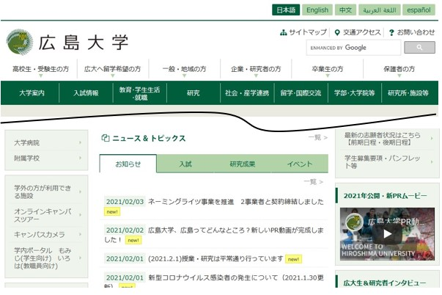
Access to “MOMIJI”
【Official Website of Hiroshima University】
Press the “MOMIJI” link.
You can also access to “MOMIJI” from URL below.
https://momiji.hiroshima-u.ac.jp/momiji-top/en/index.shtml
3

Slide 4
Contents
○ Access to “MOMIJI”
○ Course Registration

Slide 5
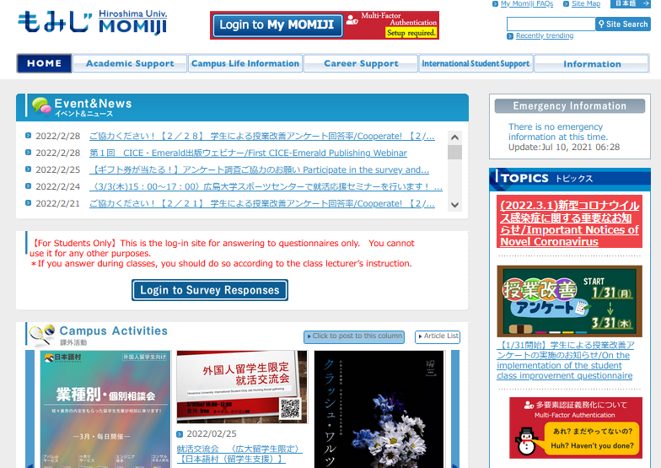
１. Log in to “My MOMIJI”
-MOMIJI Top-
＊When you use smartphone, the screen images are different from the below.
5

Slide 6
１. Log in to “My MOMIJI”
-MOMIJI Top-
Press the “Login to My MOMIJI”.

Slide 7
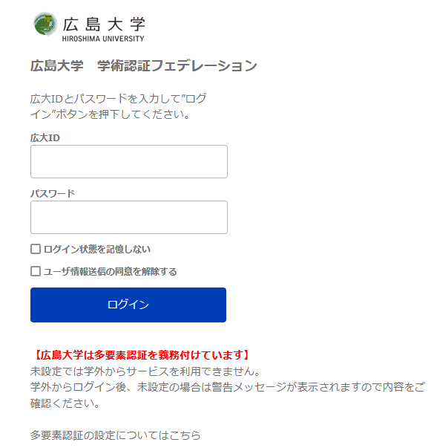
１. Log in to “My MOMIJI”
-MOMIJI Top-
広大ID：B999999 （”B” is in capitals.)
パスワード：********
Press the “ログイン”.
＊ Be sure both HU ID and Password are case-sensitive.

Slide 8
１. Log in to “My MOMIJI”
-Consent for Handling Data-
Consent for Handling Data
Written Consent on the Handling of Educational Data, Including Personal Information, in Information Systems
With the aim of improving education by analyzing the Educational Data, Hiroshima University (hereinafter, the “University”) requests your consent to handle as follows the Educational Data, including personal information, in the information systems operated by the University, in accordance with the Hiroshima University Policy for the Educational Data Utilization (formulated in 2021).
Details
1. Purpose of Use The University will use the Educational Data, including personal information, by analyzing and visualizing them, for the purpose of supporting its education, and will not use such data otherwise than for the said purpose.
2. Policy for Use The University will comply with the Hiroshima University Policy for the Educational Data Utilization (EDU Statement, Eight Principles for the Handling of Educational Data, and Guidelines on the Educational Data Utilization). ※Please refer here for the Hiroshima University Policy for the Management of Educational Data. Do you agree to be treated as described above? 〇I agree. 〇I do not agree. ※Please refer here for the FAQ on the consent.
The "Consent for Handling Data" screen will be appeared. Please read it carefully and choose "I agree" or "I do not agree“.
Then, press “Next".
Next
※ Once selected, the "Consent for Handling Data" screen will not be appeared from the next time.
(You can change your consent at any time from the "Academic Register Management" - "Consent for Handling Data" in the My Momiji menu.)

Slide 9
２. Things to check before registration
- Course Registration Period and Course Offering Schedule -
Term
1st Term
（Apr.～Jun.）
2nd Term
（Jun.～Aug.）
Summer holidays
（Aug.～Sep.）
3rd Term
（Oct.～Dec.）
4th Term
(Dec.～Feb.)
Year-end holidays
（Feb.～Mar.）
Seme
ster
First Semester
Second Semester
1 Term Courses
2 Term Courses
Out Of Term(1st)
Courses
3 Term Courses
4 Term Courses
Out Of Term(2nd)
Courses
First Semester Courses
Second Semester Courses
Timetable of Courses
Year-round Courses
Year Courses
Year Courses
Intensive Courses（Offered in a part of period）
1 Term Courses：Courses offered in the 1st Term 2 Term Courses： Courses offered in the 2nd Term
First Semester Courses：Courses offered through the first semester Out Of Term (1st)：Courses offered during summer holidays
3 Term Courses：Courses offered in the 3rd Term 4 Term Courses：Courses offered in the 4th Term Second Semester Courses：Courses offered through the second semester Out Of Term (2nd)：Courses offered during the year-end holidays Year-round Courses：Courses offered through the year
Year Courses
：Courses offered across the fiscal year Intensive Courses：Courses offered in a part of period in the year

Slide 10
２. Things to check before registration
- Course Registration Period (Add and Delete) -
Semester | Registration Period （Month） | Registration Available Courses
First | 1T Registration Period（Apr.） | 1T, 2T, First Semester, Out Of Term(1st), Year-round, Intensive during First Semester
 | 2T Registration Period（June） | 2T, Out Of Term(1st), Intensive from 2T to the end of First Semester
Second | 3T Registration Period（Sep.～Oct.） | 3T, 4T, 2nd Semester, Out Of Term(2nd), , Intensive during Second Semester
 | 4T Registration Period（Dec.） | 4T, Out Of Term(2nd), Intensive from 4T to the end of Second Semester
※：Before beginning Year courses, check registration periods etc. on the Syllabus or in the support office of the school /graduate school that offers the course.
In the first and third term registration periods, in principle, all the courses whose opening dates fall in the first and second semesters, respectively, can be registered for.In the second and fourth term registration periods, in principle, students can modify their course registration for the first and third term registration periods, respectively. Detailed information on course registration periods is provided on the MOMIJI Top page. If you cannot register for courses by My MOMIJI, first refer to the Semester/Term, Eligible Students, Requirements of the Syllabus pages and notice etc. If you cannot register even after doing so, then contact the support office of the school /graduate school that offers the course for inquiry (as for liberal arts education courses, please contact the Education Promotion Group [persons in charge of Liberal Arts Education]).

Slide 11
3. Course Registration
- From Portal Screen to “Registering/Checking Courses” Screen –
My MOMIJI portal screen
From the menu on the left side of the screen,
1. Press “Course Information”.
2. Press “Registering/Checking Courses”.
Registering/Checking Courses/Confirmation Screen
After checking the Notes of Importance, press the “OK”.
(This screen is displayed only once per semester.)
*As for new students, their Academic Register Information etc. will be added in MOMIJI in April. New students are requested to confirm their Academic Register Information etc. after such data have been added in May.
＊When you use smartphone, the screen images are different from the below after this page.

Slide 12
3. Course Registration
- “Registering/Checking Courses” Screen -
1) “Registering/ Checking Courses” screen
Selecting each tab will allow you to display and register for courses that are offered in the corresponding periods as listed below. (For the course offering schedule, see page 7.)
1Term tab: First term
2Term tab: Second term and Summer holidays
3Term tab: Third term
4Term tab: Fourth term and Year-end holidays
Ex.) Since the period during which First Semester Courses are offered extends over the first and second terms, these courses are displayed under both the 1Term and 2Term tabs. These courses can be registered for by using the 1Term and 2Term tabs.
Each tab can be switched by pressing the name link.
During the first term course registration period, you can register for courses whose opening dates fall in the first term, the second term and the Summer holidays. After registering for a first semester course through both the 1Term and 2Term tabs, be sure to confirm that it has been properly registered for. (For the course registration period, see page 8.)

Slide 13
3. Course Registration
- “Registering/Checking Courses” Screen -
1) “Registering/ Checking Courses” screen
Press the “Register” link after confirming the day of the week and time period for the course you wish to register for.
*Intensive Courses are listed under the timetable.
A course displayed within the colored field for the day of the week and time period has been registered for as a specified class, which cannot be changed by students. If you have a need to change such a course, please consult with the relevant support section.

Slide 14
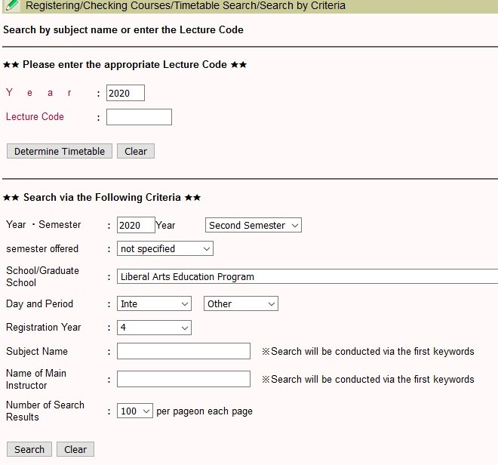
3. Course Registration
- “Timetable Search/Search by Criteria” Screen –
2) Reference to Registering/Checking Courses / Timetable Search/Search by Criteria
 If you know the Lecture Code
Directly enter the Lecture Code and press the “Determine Timetable”.
 If you don’t know the Lecture Code
Enter the search criteria and press the “Search”.

Slide 15
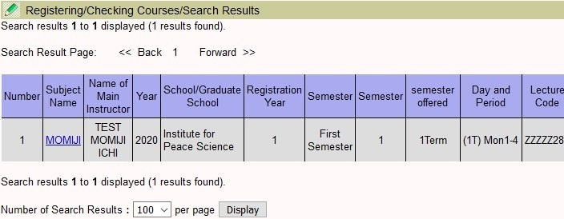
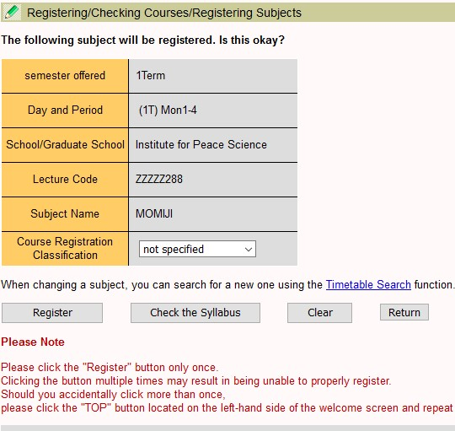
3. Course Registration
- “Search Results” Screen –
3) Registering/ Checking Courses / Search Results
Press the “Subject Name” link to register for the course you wish to take, on the timetable. The “Registering/Checking Courses /
4) Registering/Checking Courses / Registering for Subjects
After confirming the content of the course, press the “Register”.
 Course Registration Classification
If you wish to register for a course as “Credit Not Required,” first select the applicable option from the pulldown menu and then register for the course.
Please be aware that you cannot change the Course Registration Classification after the end of the course registration period.

Slide 16
3. Course Registration
- “Registering/Checking Courses” Screen-
5) When the course is properly registered for
After the course registration is checked, if there is no error, the subject is registered for, so that the “Registering/Checking Courses” screen will appear. (First Semester Courses will be displayed by pressing the 1Term and 2Term tabs, and Second Semester Courses will be displayed by pressing the 3Term and 4Term tabs.)
Be sure to confirm that there is no mistake in the registered contents of the course (Day of the Week, Time Period, Subject Name, Instructor, Course Registration Classification, etc.).
After the end of the course registration period, the contents of the course registration cannot be changed.
* When there is a course registration error
If there is a course registration error, an error message will be displayed. （Before semester courses, or other courses that are offered striding over multiple terms, are registered for, a registration check is performed for all the terms in which these courses are offered.）

Slide 17
4. Deletion of Courses
- “Registering/Checking Courses” Screen-
1) “Registering/ Checking Courses” Screen
Press the “Delete” for the time period frame for the subject you wish to delete.
A course displayed within the colored field for the day of the week and time period has been registered for as a specified class, which cannot be changed by students. If you have a need to change such a course, please consult with the relevant support section.

Slide 18
4. Deletion of Courses
- “Deleting Subjects” Screen-
2) Registering/Checking Courses / Deleting Subjects
After confirming the contents of the subject you wish to delete, press the “Delete”.
The registered information will be deleted.

Slide 19
4. Deletion of Courses
- “Registering/Checking Courses” Screen-
3) “Registering/Checking Courses” screen
The subject whose registration was deleted will disappear from the “Registering/Checking Courses” screen.

Slide 20
5. Supplementary Notes regarding Course Registration
This message will be displayed when you cannot take the course as a result of a drawing, and if you have not checked the drawing result yet. After checking the Day of the Week, Time Period and Subject Name, press the “Check”. (If the 1Term or 2Term tab is selected, information on the courses that can be registered for the First Semester will be displayed. If the 3Term or 4Term tab is selected, information on courses that can be registered for the Second Semester will be displayed.)
Pressing here will display specific course information of the liberal arts education program.
Intensive Courses are listed under the timetable.

Slide 21
5. Supplementary Notes regarding Course Registration (2)
Liberal arts education courses may not be registered for from “My MOMIJI” even during the registration period, for various reasons, which include the following:
• As a result of various checks for registration limitations, you are judged to be unable to take the course (the relevant error message(s) will be displayed on the screen.)
• You were not selected in the drawing that was held to decide who can take the subject, or the class number limit has been exceeded.
• The subject is specified for you to take based on the designated class schedule and requires students to attend its first class as a condition for its registration.
For further information concerning the registration procedure for each course category, please refer to “MOMIJI Top → Academic Support → Liberal Arts Education”. More detailed information on each course is available by selecting “My MOMIJI → Syllabus → Browsing Syllabus”.
 Website of Liberal Arts Education
(MOMIJI Top → Academic Support → Liberal Arts Education → Procedures in Liberal Arts Education)
URL: https://momiji.hiroshima-u.ac.jp/momiji-top/en/learning/kyouyou/procedure.html
If you cannot register for courses and you do not understand the reason, please contact the Education Promotion Group (person in charge of liberal arts education) on the 1st floor of the administration building of the School of Integrated Arts within the course registration period.
If you cannot register for specialized education courses through My MOMIJI, please contact the support office of the school/graduate school that offers these courses.

Slide 22
6. Logout from My MOMIJI
Logout
Press the “Logout”.

Slide 23
Summary –Notes of Importance regarding Course Registration-
 To log in to My MOMIJI, you need your HU ID and HU Password.
 In the first term registration period, you can register for all courses that begin in the first semester. In the second term registration period, in principle, you can modify the registration of courses which begin from second term to the end of First semester. (The same holds true to the second semester.)
 Depending on the school/graduate school, there may be other notes of importance regarding the registration procedure.
 Be sure to check the registration status during the course registration checking and modification periods. In particular, please be aware of the results of the drawing held to decide who can take the course.

Slide 24
Contact Information
If you have questions regarding course registration requirements, contact:
 Support office ((person in charge of student support) of your school/graduate school）
If you cannot register for courses and you have questions
 About liberal arts education courses, contact:
→ Education Promotion Group (person in charge of Liberal Arts Education)
 About other courses, contact:
→ Support office (person in charge of student support) for the school/graduate school that offers the courses in question

Slide 25
Contact Information
If you have other questions regarding the use of My MOMIJI, contact:
Business system inquiry counter
082-424-5609 (Extension: Higashi-Hiroshima 5609)
systemhelp@hiroshima-u.ac.jp

