Slide 1
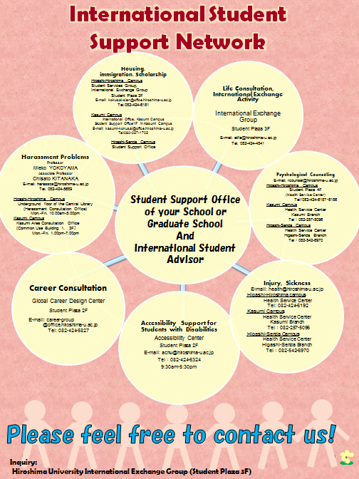

Slide 2
Academic Consultation
International Student Advisor
Associate Professor
Naoe KAWAMOTO
Graduate School of Integrated Arts and Sciences

Slide 3
Academic consultant matters
Example:
○Conflict between international students and supervisors
(Difficulties of getting consensus about research topic, differences of research style, less guidance, etc.)
○Cultural adjustment difficulties in learning
(Language, lecture style, etc.)
○Conflicts with lab mates regarding research collaboration/ using lab rules
○Less understanding information from office
(Language, Degree/credits system, certification, etc.)
○Uncertainly/anxiety about future education/ career

Slide 4
Rules for research students
Admission for research will be canceled if a research student doesn’t pay their research fees within 3 months of the date of admission.
After Admission We will check research progress by means of a record written by the research student which depicts specific study/research contents using the format of “Research journal 「研究日誌」” etc..

Slide 5
Student Supporter System for Newly Arrived International Students
【Role of Student Supporter】
To assist smooth settlement of newly arrived international students
in new environment within and around campus.
1. Daily Life Support
Pick-up from airport/station; Completion of move-in procedures at City Hall;
Assistance to settle in dormitory/apartment( incl. electricity, gas, and water);
Opening a Bank Account; Purchasing daily necessities, etc.
2. University Life Support
Assistance to apply for tuition exemption/scholarships; Course registration
Explaining how to use facilities in campus; Accompanying orientations, etc.
*Period of support : Actual support and maximum hours of service will be
decided in consultation with Student Support Offices.

