Slide 1
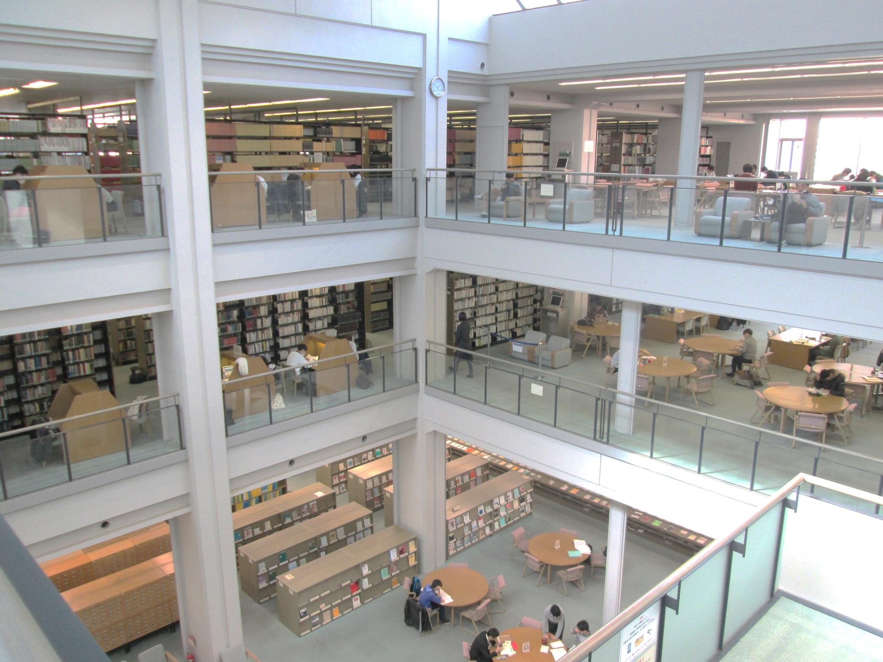
Introduction to University Library

Slide 2
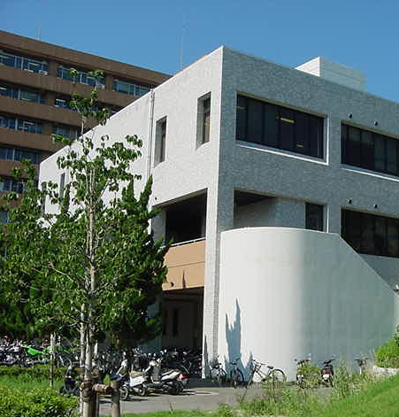
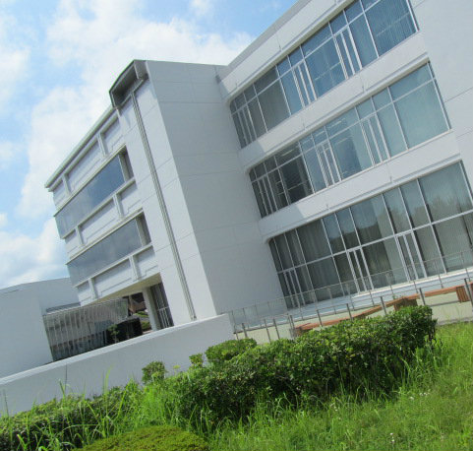
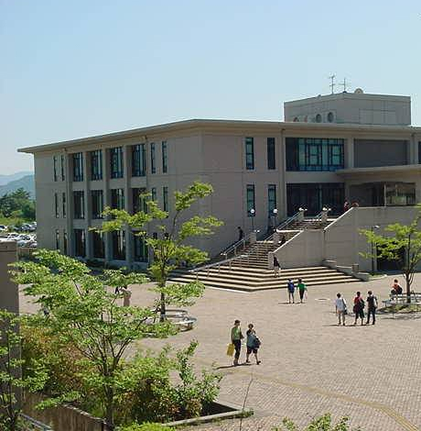
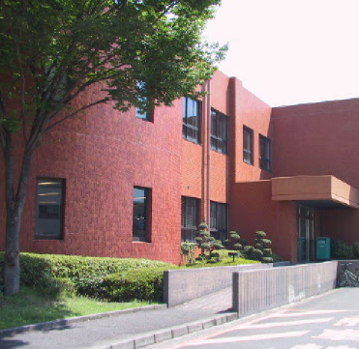
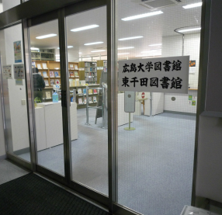
We have
five
libraries
Central Library
East Library
West Library
Kasumi Library
Higashi-Senda Library

Slide 3
How to Borrow Books
Books
Student ID
How many and how long can I borrow books?
Graduates : 15 books in 30 days
Undergraduates: 10 books in 3 weeks

Slide 4
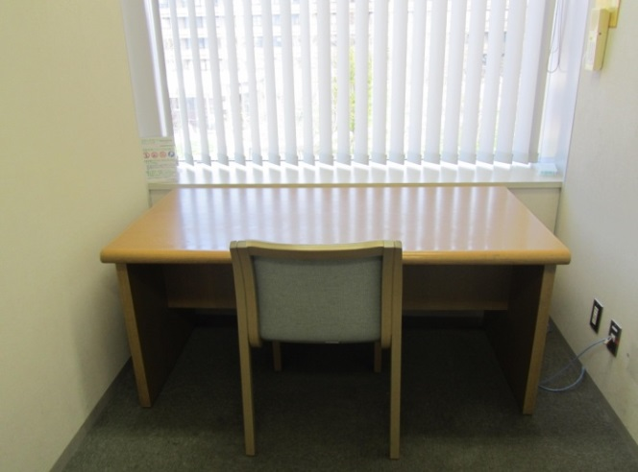
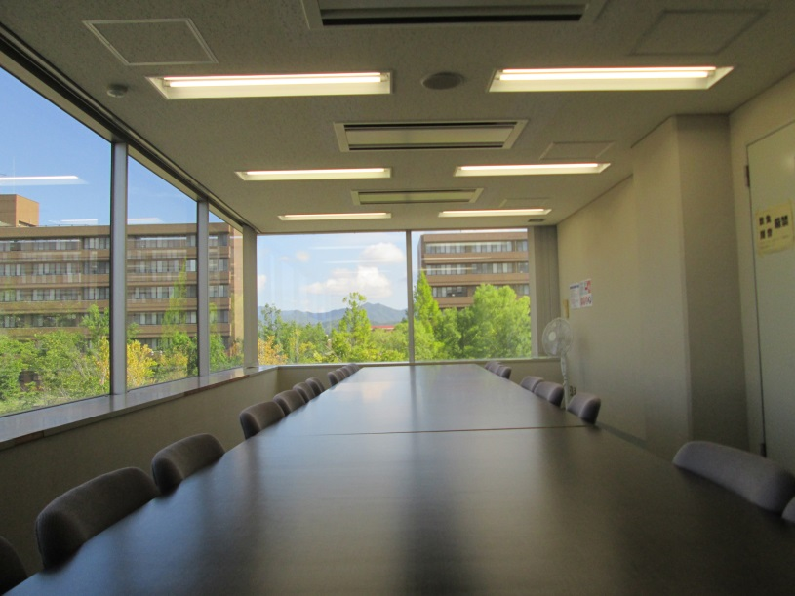
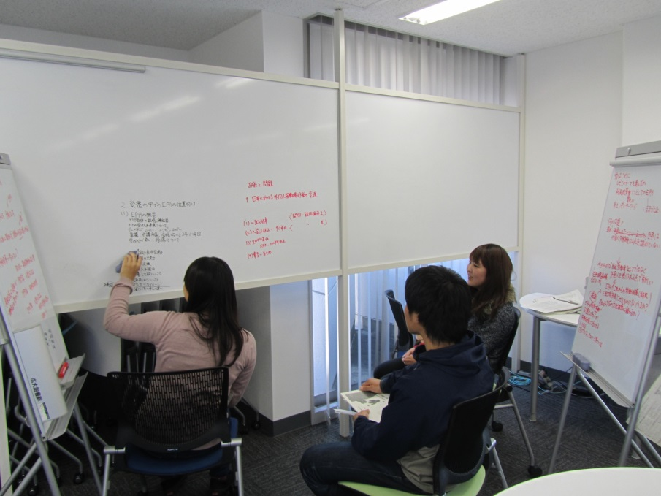
Study Spaces
Private study
Meeting
Discussion

Slide 5
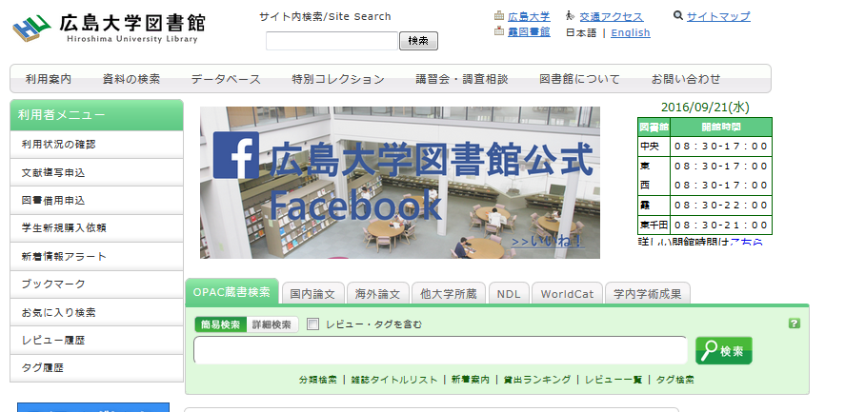
Website of University Library
http://www.lib.hiroshima-u.ac.jp/
Online catalog, electric journals, databases are available in library website.

Slide 6
Hiroshima University Library
@HiroshimaU_Lib
HiroshimaULib

